Slide 1
INTERNATIONAL ACCREDITATION FORUM
“Certified Once, Accepted Everywhere”
Last Updated June 2020

Slide 2
What is the IAF
The International Accreditation Forum (IAF) is a global association of:
Accreditation Bodies
Regional Accreditation Groups
Certification Body Associations
Industry Associations
Other stakeholder organizations and scheme owners for certification of management systems, products/processes/services and personnel, and validation/verification

Slide 3

VISION:
Accreditation makes the world better.
MISSION:
IAF facilitates trade and supports sustainable development using internationally recognized accredited conformity assessment to deliver the confidence needed for market acceptance of goods and services.

Slide 4

The Objectives of IAF
To maintain and develop a Multilateral Recognition Arrangement (MLA) among Accreditation Body Members to ensure recognition of accredited certification among signatories.
To act as a global forum to bring together accreditation bodies and stakeholder groups to facilitate global trade.
To develop appropriate harmonization of certification best practices.
To promote accredited certification by working with, and influencing, key international organizations and industry groups.

Slide 5
The Benefits of IAF
MLA underpins cross border trade through the acceptance of certifications. “Certified once, accepted everywhere”.
Coordination to harmonize best practices.
Platform to exchange information and knowledge.
Technical assistance and development services to support developing countries to establish certification infrastructure.
Support to developing and emerging economies.
Links with ILAC, international standardization bodies and trade organizations.

Slide 6



The Benefits of Standards and Accreditation in Practice
www.publicsectorassurance.org – demonstrates how standards and accreditation support public policy through case studies and research papers.
www.business-benefits.org – case studies and research that demonstrate how standards and accreditation provide ‘monetary’ benefits to businesses.

Slide 7
The IAF Structure
General Assembly represents the highest decision-making body.
Board of Directors is responsible for developing broad policy directions for IAF and for ensuring that the work of IAF is carried out in accordance with policies approved by Members.
Executive Committee is responsible for the day-to-day work of IAF on the basis of decisions made by Members and the Board.
Operations of all IAF Committees and Subordinate Groups are subject to the IAF General Procedures.

Slide 8
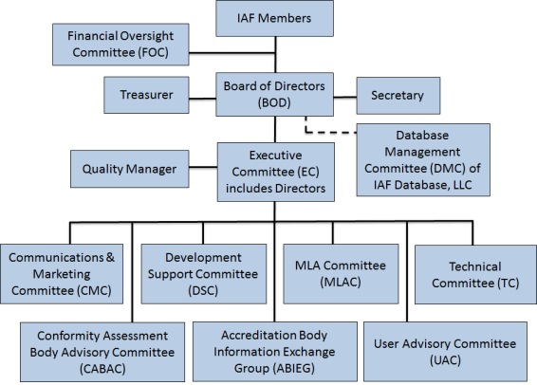
The IAF Structure

Slide 9
Types of IAF Members
Membership of the IAF is separated into a number of categories:
Accreditation Body Membership
For accreditation of bodies certifying management systems, products, services, or personnel.
Association Membership
Open to other organizations involved in the use or implementation of certification systems.
Regional Accreditation Group Membership
Groups of Accreditation Bodies which maintain Multilateral Recognition Arrangements of each other’s accreditations.

Slide 10
The International Picture
Formed in 1993, IAF membership has increased, as has its influence with international organizations and trade bodies.
Growing complexity of international trade and growth in number of certification bodies increases need for IAF recognition.
An increasing number of nations have established accreditation bodies to maintain competence of certification bodies.

Slide 11
The IAF MLA
A network of accreditation body members of IAF deemed competent through a stringent peer evaluation process.
Signatories to the MLA recognize each other as being equally reliable.
Provides assurance that equivalent overseas certification bodies operate to the same standard as those in their own country.
There are currently five main scopes: Management Systems, Product Certification, Certification of Persons, Greenhouse Gas Validation and Verification, and Validation and Verification
There are currently seven sub-scopes for Management Systems (QMS, EMS, ISMS, FSMS, MDMS, EnMS, FAMI-QS), one for Product (GlobalG.A.P Integrated Farm Assurance), one for Persons (IPC Management System Auditors), and one for GHG Validation and Verification (ICAO CORSIA Version 1).

Slide 12
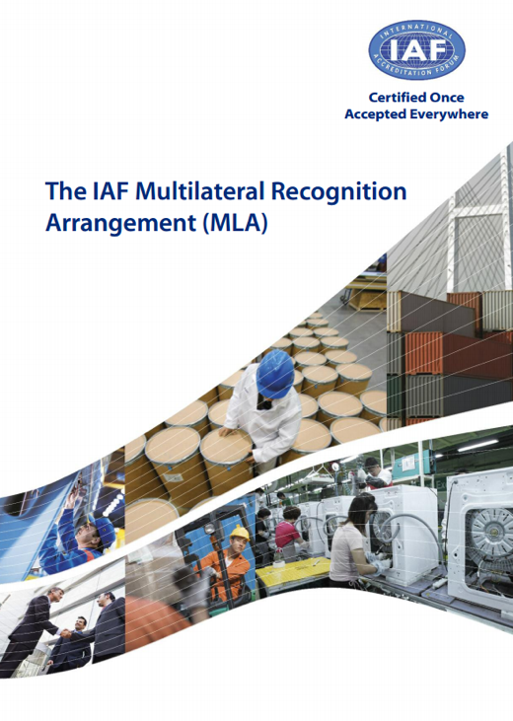
The IAF MLA
Certificates/statements issued by bodies accredited by IAF signatories in the fields of management systems, products, personnel, and validation and verification can be accepted as equivalent worldwide.
Acceptance removes unnecessary, multiple certifications.
Reduces time to market as well as additional cost to business.
The key to the MLA is the increasing global network of accredited conformity assessment bodies by IAF MLA signatories.

Slide 13
Coverage of the IAF MLA
IAF MLA Signatories
IAF Members not yet Signatories
Correct as of June 2020
Notes:
13

Slide 14
Status of the IAF MLA (June 2020)
There are 74 IAF MLA AB Signatories in the following main scope and sub-scope areas:
Main Scope:
Management systems
Product
Persons
Validation and Verification
GHG Validation and Verification
Sub Scope Level 4:
Global G.A.P. IFA General Regulations
ISO/TS 22003 FSMS
ISO/IEC 27006 ISMS
ISO/IEC TS 17021-3 QMS
ISO/IEC TS 17021-2 EMS
ISO 50003 EnMS
Sub Scope Level 5:
ISO 9001 QMS
ISO 14001 EMS
ISO 22000 FSMS
ISO/IEC 27001 ISMS
Global G.A.P. IFA CPCCs
FAMI-QS Certification Scheme
ISO 13485 MDMS
ISO 50001 EnMS
IPC-PL-11-006
Applications are being accepted for the above and the following scopes: ICAO CORSIA Version 1

Slide 15




Regional Cooperation Bodies
The IAF MLA builds on existing regional MLAs established around the world.
European Cooperation
for
Accreditation
(EA)*
Asia Pacific
Accreditation Cooperation Incorporated
(APAC)*
Inter-American
Accreditation Cooperation
(IAAC)*
Southern African
Development
Community Accreditation
(SADCA)**
African Accreditation Cooperation (AFRAC)*
Arab Accreditation Cooperation (ARAC)*
* Recognized Regional Accreditation Group Member
** Regional Accreditation Group Member

Slide 16
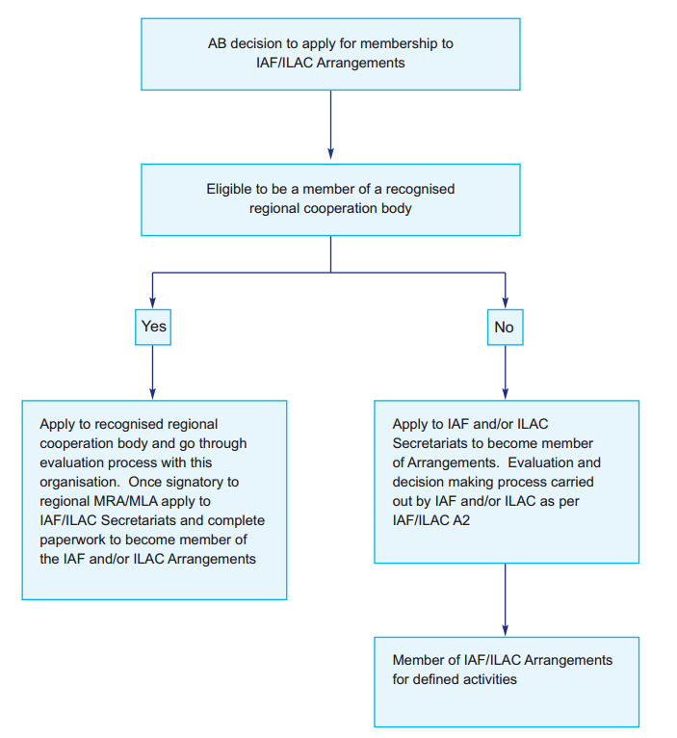

Route to the Arrangements

Slide 17

The IAF MLA Mark
Use of the IAF MLA Mark allows a business seeking certification to confirm at a glance that a certification body is accredited by an accreditation body that is a signatory to the IAF MLA.
As a result, businesses will benefit from having increased confidence, signified by the presence of the IAF MLA Mark, that requirements have actually been met.
AB SYMBOL

Slide 18
The IAF MLA Mark
Combined mark:
Can only be used in association with the IAF MLA main scopes and/or sub scopes for which AB is a signatory to the IAF MLA.
May be used on accreditation certificates, letterheads, quotations for work, advertisements, or websites.
Shall not be used on or in conjunction with products.

Slide 19
The IAF MLA Mark
Use by Accreditation Bodies
Have to be an IAF MLA signatory to use the Mark
Have to have a license with the IAF before they can use the IAF MLA Mark.
Can only use the IAF MLA Mark in combination with their own logo as a combined mark, as below.
AB SYMBOL

Slide 20
The IAF MLA Mark
Use by Accredited CBs
IAF AB MLA signatories can sub-license use of mark to accredited CBs for recognized scopes and sub-scopes.
CBs can only use the IAF MLA Mark in combination with the CB’s name/symbol and the Licensee’s accreditation symbol as a combined mark, as shown below.
AB SYMBOL/CB SYMBOL

Slide 21
The IAF MLA Mark
Use by accredited CBs (cont.)
Combined mark shall not be used on or in conjunction with products.
CB shall not allow customers to use the combined mark.
AB may add any conditions that it deems necessary to protect the IAF MLA Mark.

Slide 22
The IAF MLA Mark
Use of Combined Mark by accredited CABs Cont.
Can only be used in association with activities for which the CAB is accredited and are within the AB’s IAF MLA main scopes.
May only be used by CABs on accredited certificates where the scope of the certificate includes an IAF MLA sub-scope.
May be used by CABs in letterheads, quotations for work, advertisements, or websites where the CAB is accredited for a main scope or sub-scope.

Slide 23
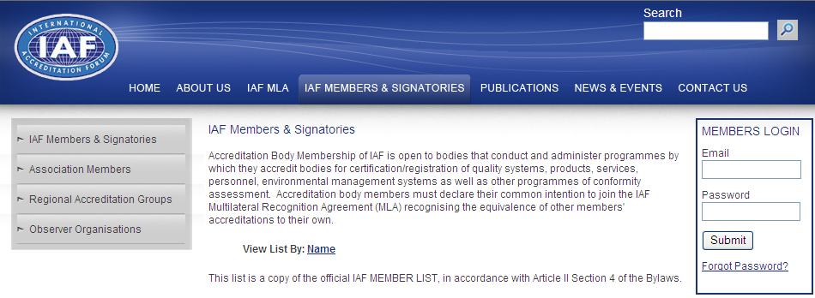
How to find an IAF MLA Signatory
A ‘live’ and complete list of signatories can be found on the IAF website at www.iaf.nu/articles/IAF_Members_Signatories/

Slide 24








IAF Partners
IAF works with a number of organisations and cooperates with many international bodies to achieve shared objectives. IAF has signed MoUs with the following nine organisations:
International Telecommunications Union
International Laboratory Accreditation Cooperation
International Organization of Legal Metrology
International Organisation for Standardisation
UN Industrial Development Organisation
International Electrotechnical Commission
World Bank
International Halal Accreditation Forum
International Civil Aviation
Organization
GLOBALG.A.P.

Slide 25
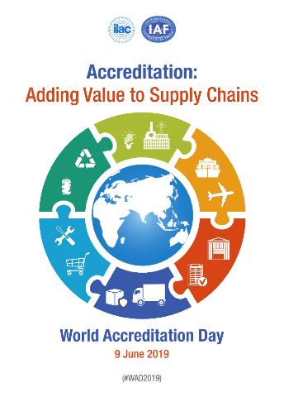



World Accreditation Day
World Accreditation Day takes place on 9th June each year. A theme is agreed by the Joint Executives, and materials are available from the ILAC and IAF websites to support promotion in your economy. Major conferences, events, workshops, and press campaigns take place in over 90 economies.

Slide 26
Sources of Further Information
To remain up-to-date with developments, the following sources of information are available:
IAF Outlook – published quarterly.
http://www.iaf.nu/articles/IAF_Newsletter/164
IAF Publications – a wide range of publications are available to download from:
http://iaf.nu/articles/Publications/6/
Annual Reports - IAF publishes an Annual MLA report each year that sets out the key developments and status of the MLA.
Follow IAF on Twitter, LinkedIn and Youtube

Slide 27
INTERNATIONAL ACCREDITATION FORUM
www.iaf.nu
For more information contact:
The IAF Secretariat
Elva Nilsen
Email: iaf@iaf.nu

